Slide 1
Optics for Soft X-ray Seeding of LCLS-II
- Grating and Mirrors
Y. Feng, J. Wu, M. Rowen, P. Heimann,
J. Krzywinski, J. Hastings, et al.

Slide 2



Outline
Motivations
Requirements
  Input FEL parameters
  Transform-limited pulses
  Seeding power
X-ray optics
  Grazing-incidence Grating Monochromator
    Fixed-focal point operation
    Resolving power
    Efficiency
  Mirrors
    Pre-mirror
    Vertically focusing mirror
    Horizontal focusing mirror
Ray-tracing results
Summary

Slide 3
Schematics of Self-seeding FEL
Originally proposed at DESY [J. Feldhaus, E.L. Saldin, J.R. Schneider, E.A. Schneidmiller, M.V. Yurkov, Optics Communications, V.140, p.341 (1997) . ]
chicane
1st undulator
2nd undulator
grazing mirrors
FEL
slit
SASE FEL
Seeded FEL
grating
electron
Electron dump

Slide 4
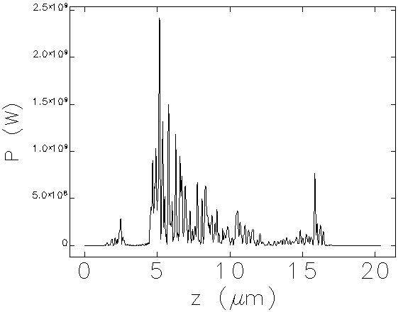
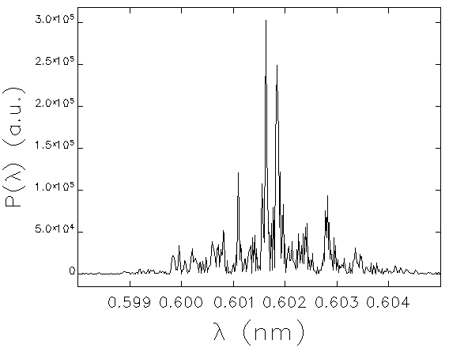
Motivations
SASE FEL temporal characteristics
  Coherence time << pulse duration
  Goal ➔ make temporally fully coherent pulses
6 Å SASE FEL spectrum at 26 m in the first undulator
6 Å SASE FEL temporal profile at 26 m in the first undulator
τ_{c}
(λT/2π)·1/ΔT
ΔT
(λT/2π)·1/τ_{c}
~ 12 fs

Slide 5
Requirements
Input FEL parameters
  Energy range
    200 – 2000 eV
  Pulse length
    200 eV: 34 fs rms*, peak current 1 kA
    2000 eV: 12 fs rms*, peak current 3 kA
  Pulse energy
    200 eV: 1.2 μJ, peak power ~ 10 MW
    2000 eV: 40 μJ, peak power ~ 1 GW
  e-beam size
    200 eV: 50 μm rms†
    2000 eV: 15 μm rms†
*Note: FWHM = √12 rms
†Note: FWHM = 2.354 rms

Slide 6
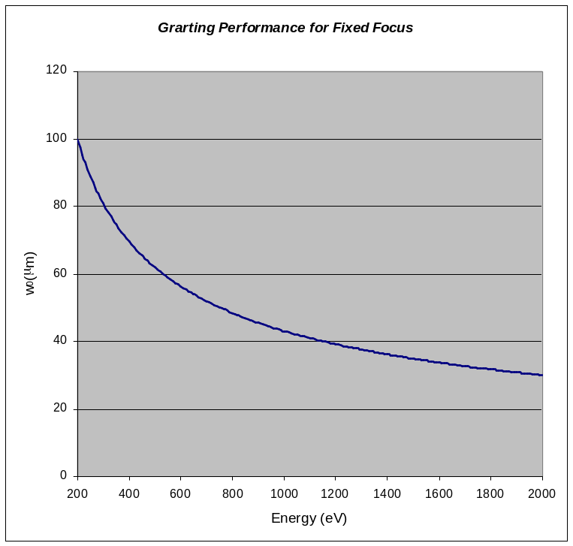
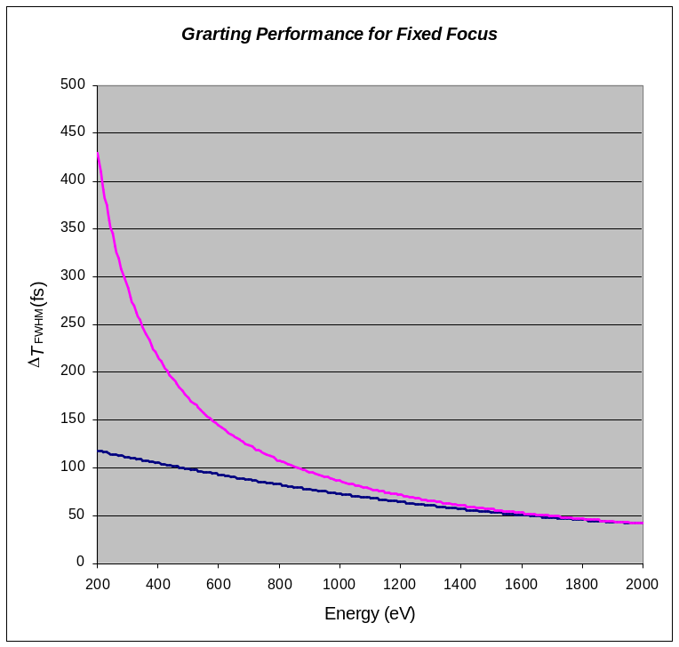
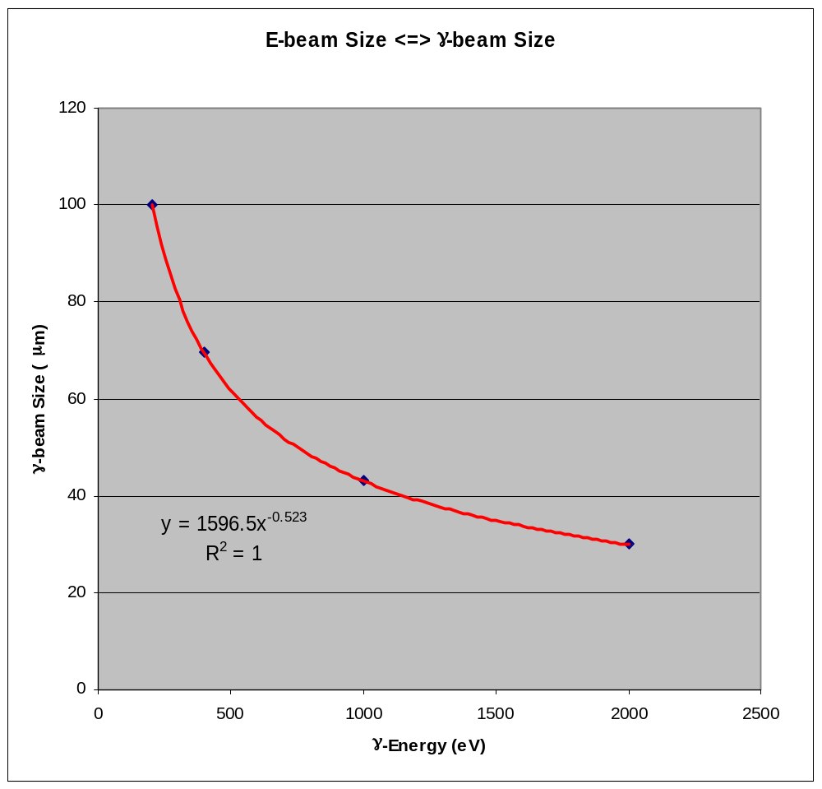
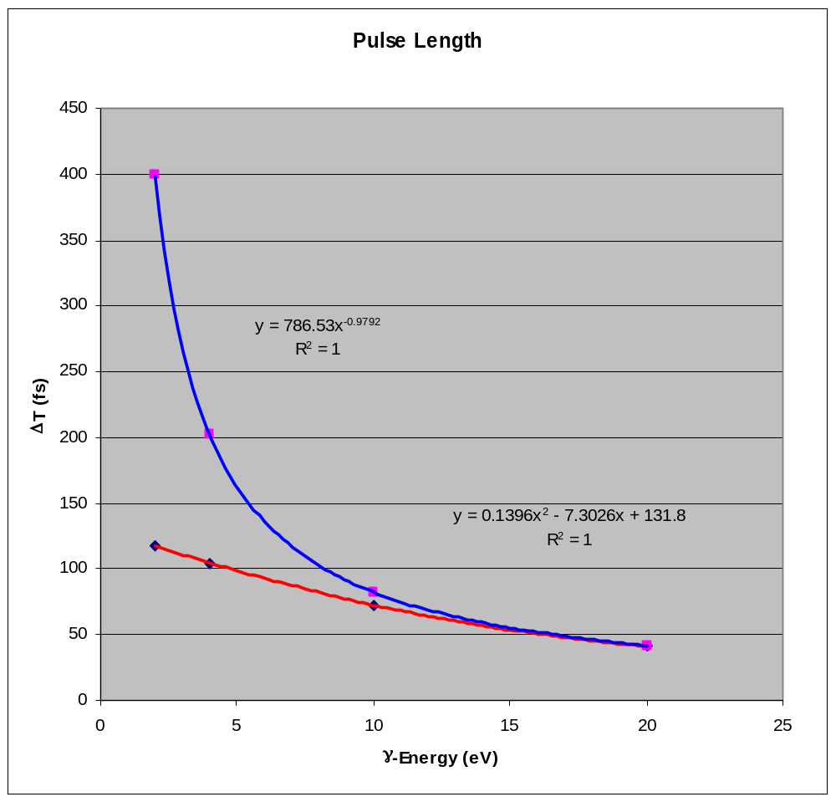


Requirements
Input FEL parameters (cont’d)
  X-ray beam size
    Energy dependent
      Loosely speaking
        w₀ ~ w_{e}~ √ε
    Transversely fully coherent
      Gaussian optics necessary
  X-ray pulse length
    “Design goal” pulse length
    Maximum pulse length
      Afforded by optics to be transform-limited
maximum pulse length
maximum
design goal
design goal

Slide 7

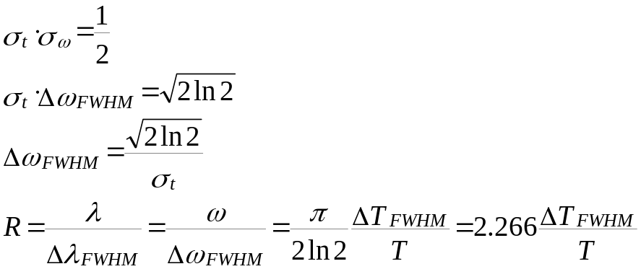
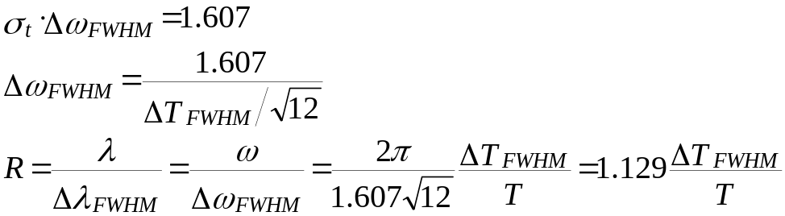
Requirements
Transform-limited pulses
  For a (temporal) Gaussian beam
  For a (temporal) flat-top beam

Slide 8
Requirements
Performance requirements
  Resolving power to make pulse fully transform-limited, assuming flat-top profile
    200 eV
      ΔT_{FWHM} =117.78 fs
      R = 6428
    2000 eV
      ΔT_{FWHM} =41.57 fs
      R = 22689
  Seeding power after all optics
    200 eV: > 10 kW
    2000 eV: > 20 kW
  Seeding beam collinear w/ original beam
    Transverse profile maintained if possible
  Time delay
    ~ 10 ps
    Variable delay in tuning range is acceptable if within 10%

Slide 9
Requirements
  Operational requirements
    Energy tuning should be simple
    Use fewer gratings as possible
      Use one or two gratings to cover entire energy range if possible
    Use fewer mirrors as possible
      Reflection loss minimized
      Alignment easier
      Alignment easily maintained
    Use fewer and simpler mechanical motion as possible
      Keep incident angle constant if possible especially in curved-mirrors
      Use simple not convoluted motion if possible

Slide 10
X-ray Optics
Optical components
  Cylindrical horizontal focusing M₁
    Focusing at re-entrant point
  Planar pre-mirror M₂
    Varying incident angle to grating G
  Planar variable-line-spacing grating G
    Focusing at exit slit
  Exit slit S
  Spherical vertical focusing mirror M₃
    Re-collimate at re-entrant point
e-beam
source
point
M₁
M₃
re-entrant
point
γ
M₂
η
G

Slide 11
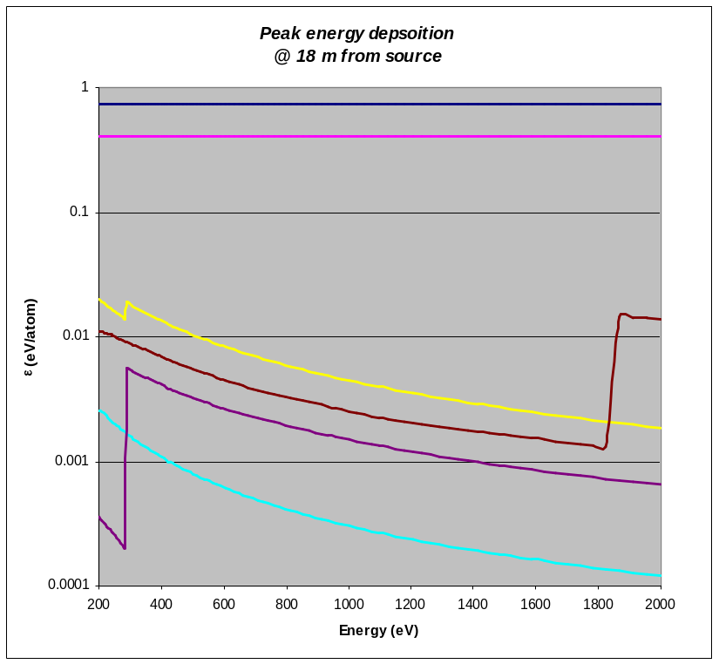
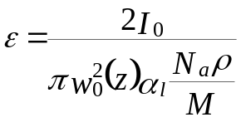
Grating Monochromator
Grating materials
  Si single crystal substrate
    Proven fabrication technology
    Superb roughness specs
    But coating is needed
Sustaining FEL full power
  At normal incidence
    200 eV: 1.2 μJ
    2000 eV: 40 μJ*
  Peak energy deposition (per atom)
    At z = 18 m
      w₀(z = 18 m) = 122 - 369 μm
      Be is best, but coating unclear
      B₄C, C coatings are safe but k-edge at ~ 283 eV
      Si is also safe but k-edge at ~ 1824 eV
*Note: increased from original spec by 10x

Slide 12
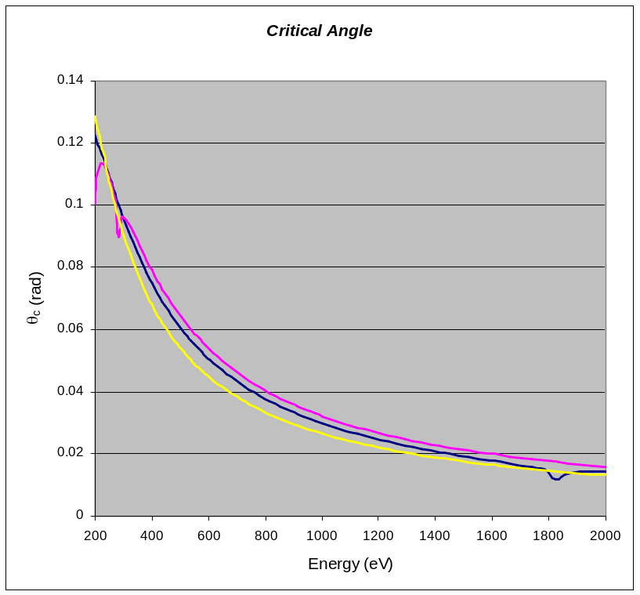
Grating Monochromator
  Use material void of absorption edges if possible
    Be, Si are good for energy < 1800
    B₄C, C are good for energy > 300 eV
  Efficiency as high as possible
    Must operate close to θ_{c}
    Critical angle θ_{c}
      Similar for almost all light material
      Be, B₄C, C, and Si are fine
      Almost linear in λ
Si
B₄C
Be

Slide 13




Grating Monochromator
Grating Equation
  Since θ and θ ’ are both arbitrary, special conditions relating θ and θ ’ can be imposed for special modes of operation
    Constant incidence angle mode
    Constant included angle mode
    Constant focal-point mode
c
b
Grating ➔ Angular dispersion
Focusing is needed for obtaining resolving power
σ
σ_{L}
θ ’
θ
d
H_{G}
a

Slide 14
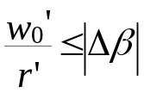
Focusing
Focusing requirements
  Imaging angular size < grating angular dispersion
      r ’ ~ 6 m
      Image angular size < 1.14 μrad
        w₀’ < 6.84 μm
  Possible solutions
    Focusing pre-mirror
    Spherical grating (fixed line spacing)
    Plane variable line spacing (VLS) grating
    Spherical +VLS grating
λ+Δλ
w₀
w₀’
λ
r
r’
Focusing element
(VLS)
exit slit

Slide 15
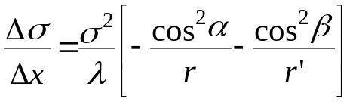
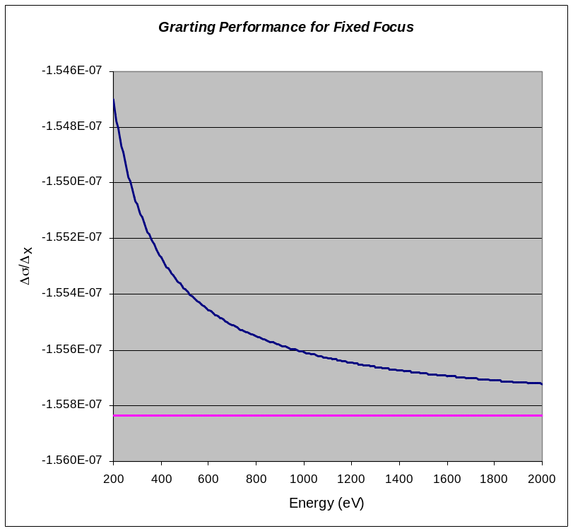
Variable Line Spacing Grating
VLS focusing
  Focusing condition
    Linear coefficient
      r, r ’ are positive
  If operate in fixed focal-point mode
    Δσ/Δx weakly energy dependent
    Can only have a fixed linear coeff.
      Defocusing effect (to be discussed)
        No impact on resolving power
        Big impact on transverse profile
Required for exact fixed focal-point
small angle (high energy) limit
w₀
λ (α+Δα)
r’
w₀’
r
α
β
Δβ
λ (α+Δα)
Δα
σ
σ+Δσ
x

Slide 16
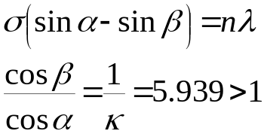
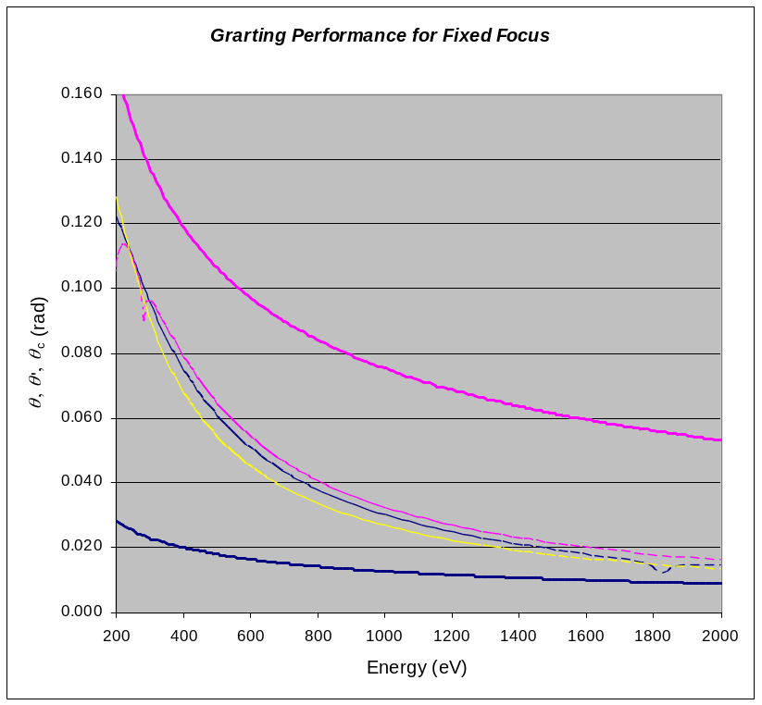
Mode of Operation
Fixed focal-point mode
    σ = 0.45 μm (2222 l/mm)
    n = 1
    “Fixed” focal-point
      “Fixed” exit slit
      Included angle α+β variable
        Rotation of pre-mirror
        Rotation of grating
    Use outside order
      Smaller θ for larger footprint
Exit angle θ’
Critical angles for
Si, B₄C, and Be
Incident angle θ
+1 order
α
β < α
0th order
θ
θ ’

Slide 17
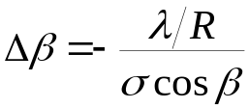
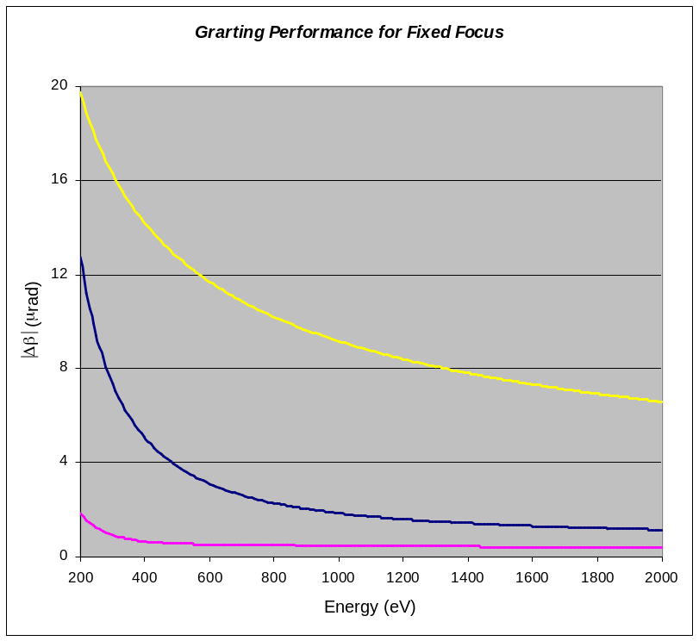
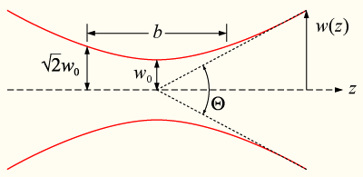
Angular Dispersion
Angular dispersion
    At required resolving power R
    Much smaller than diffraction
      Never be separated unless focused
diffraction-limited divergence
λ+Δλ
λ+Δλ
λ
Δβ
λ
α
β
grating dispersion |Δβ|
λ+Δλ
VLSG focusing
λ
Z_{R}

Slide 18
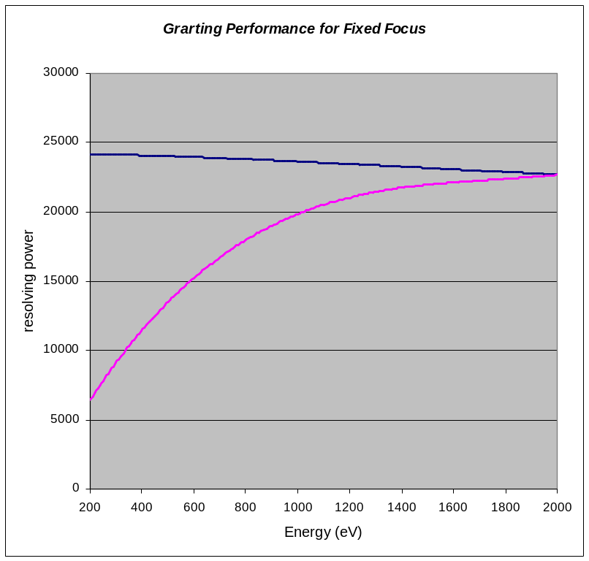
Resolving Power
Contributions
  Quadrature addition of all terms
    # of grating grooves
      Size of incident beam
      Footprint
    Entrance slit
      Slit-less, defined by incident beam
    Exit slit
      Image size
      Slit setting
    Slope error
Effective resolving power
Transform-limited pulse

Slide 19
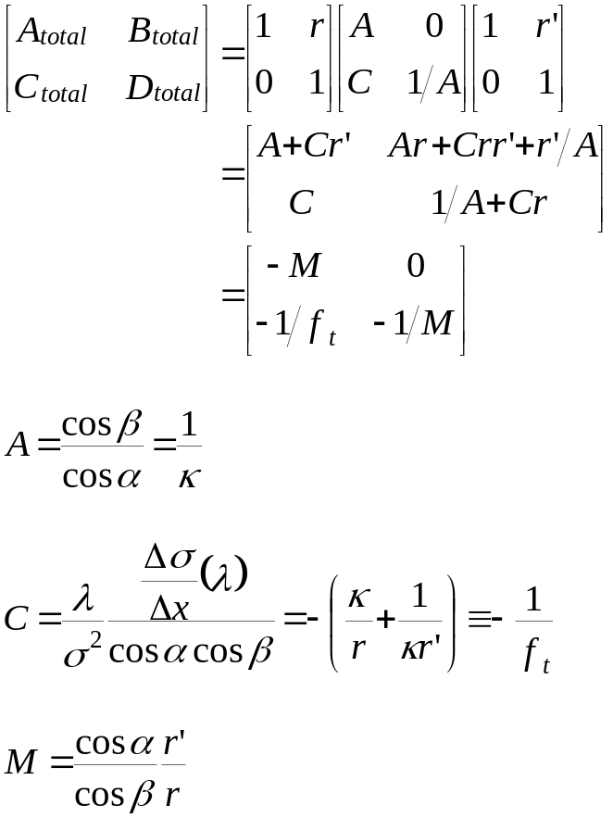


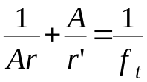
Coherent Beam Propagation
Use Gaussian beam propagation as 1st order approx.
  Formulated based on ABCD matrix for ray-optics
object
image
r
r’

Slide 20
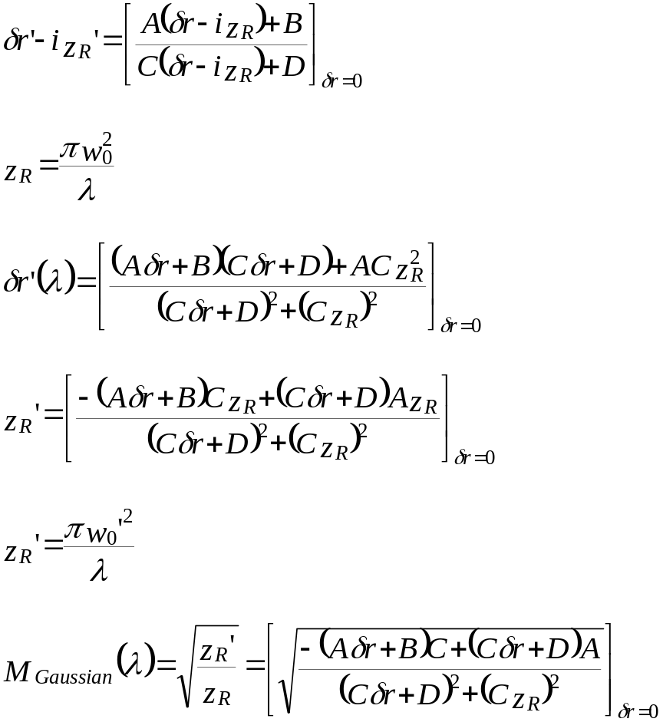
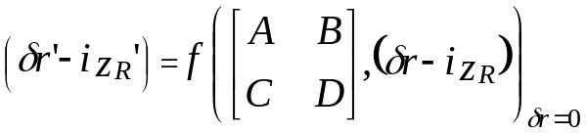
Coherent Beam Propagation
  (Total) ABCD matrix for Gaussian beam
    Waist location δr
    Rayleigh length z_{R}
object
image
w₀
w₀’
z_{R}
z_{R}’
r
r’(λ)
δr’(λ)
r’_{non-coherent}

Slide 21
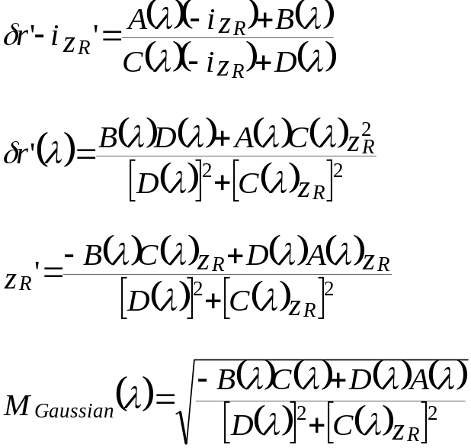
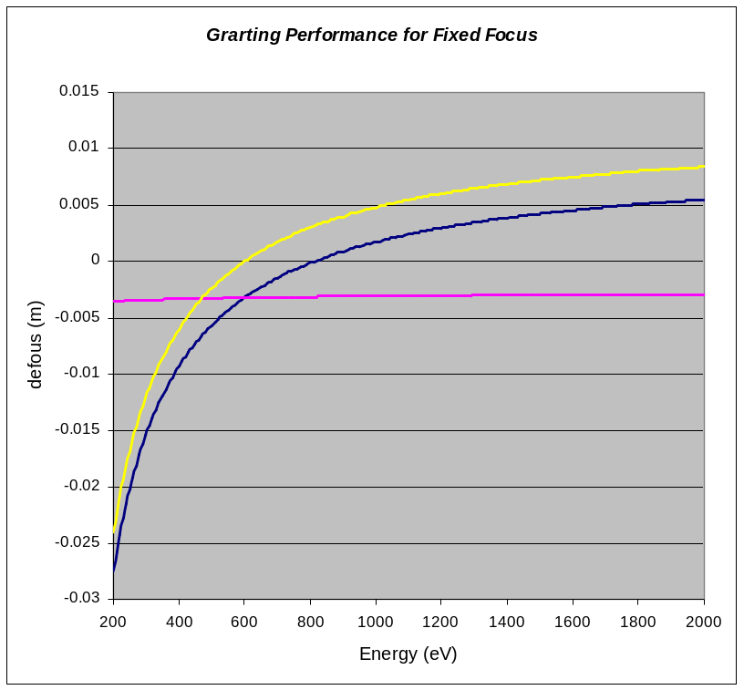
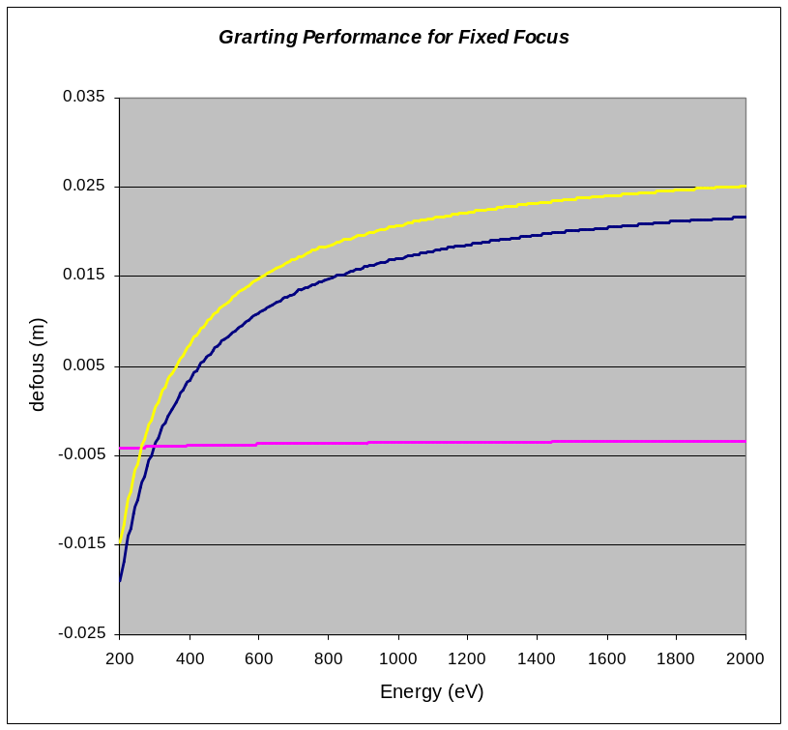
Coherent Beam Propagation
  ABCD matrix for Gaussian beam w/ const. Δσ/Δx
const. Δσ/Δx
Gaussian beam + const. Δσ/Δx
Gaussian beam

Slide 22
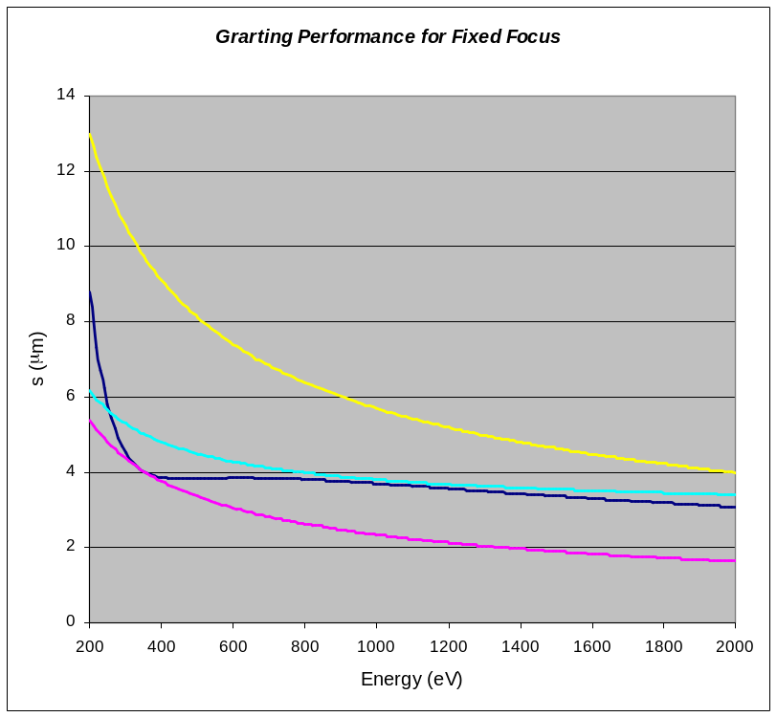
Image at Exit Slit
Image formation
  Waist location shift about slit
  Flat wavefront at waist
  Curved wavefront at slit
    Impact on collimation calculation
slit size
at slit
slit
waist
at waist w/ slope error
w₀’
at waist
z_{R}’
δr’(λ)
r’_{non-coherent}

Slide 23
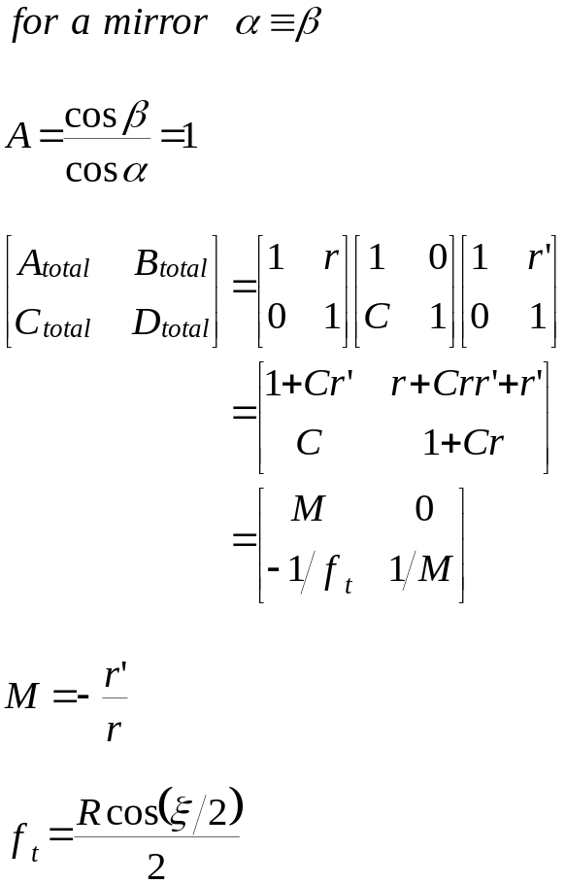
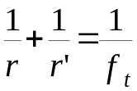
Re-Collimation
Re-Collimation after exit slit
  ABCD matrix
object
image
f_{t}
r
r’
φ

Slide 24
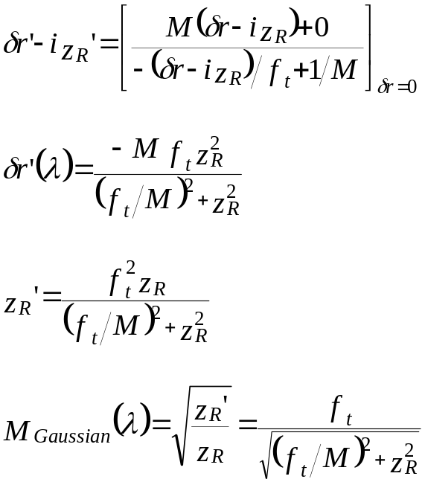
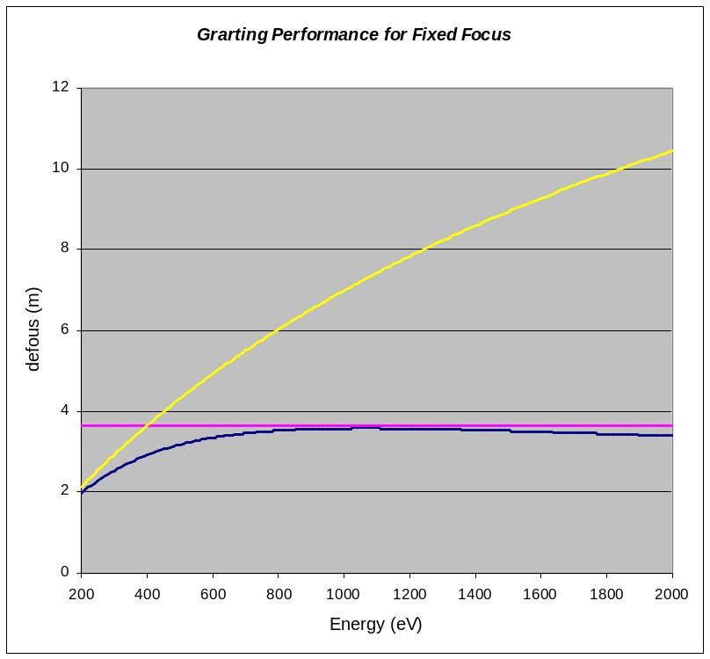
Coherent Beam Propagation
  ABCD matrix for Gaussian beam w/ const. ξ
Designed Location of waist
(ray-optics location)
Designed location of re-entrant point
Actual location of waist
image
Re-entrant
point
Ray-optics
location
object
w₀’
w₀
z_{R}
z_{R}’
r’(λ)
δr’(λ)
r
r’_{non-coherent}

Slide 25
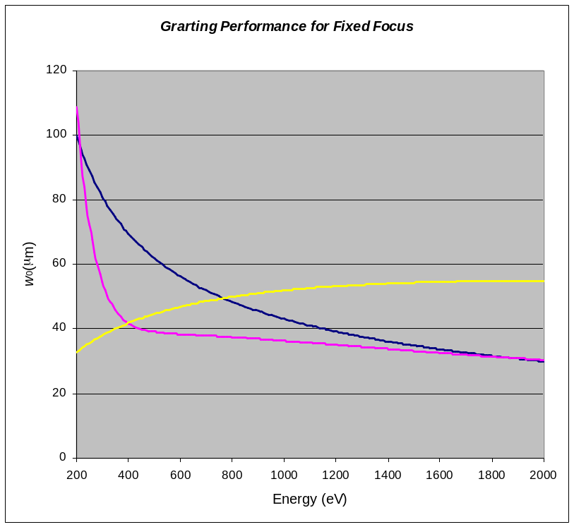
Beam Size in Dispersion Plane
Beam size evolution
  Grating
  Collimation mirror
w₀
w₀’
object
image
z_{R}
z_{R}’
δr’(λ)
source
r
r’(λ)
Ray-optics
r’_{non-coherent}
w₀
w₀’
Ray-optics
location
Re-entrant
point
object
image
Re-entrant
point
z_{R}’
z_{R}
r’(λ)
δr’(λ)
r
r’_{non-coherent}

Slide 26
Dispersion Plane
Optical components
  Deflecting mirror
  Pre-mirror
  VLS Grating
  Collimation mirror
M₁
M₂
G_{v}
M₃
Z_{R}
w₀’’
w₀
w₀’
L₁
r_{M1M2}
r_{M2G}
r’_{G}
r_{M3}
r’_{M3}
ΔL_{Re-entrant}
r_{total}
 | L₁ | L_{M1M2} | r_{M2G} | r’_{G} | r_{M3} | r’_{M3} | ΔL_{Re-entrant} | r_{total}
200 eV | 13.761030 | 4.204372 | 0.036709 | 5.981053 | 0.351780 | 1.993796 | 1.656204 | 27.984945
2000 eV | 13.761030 | 3.901582 | 0.339127 | 6.021674 | 0.311159 | 3.400840 | 0.249160 | 27.984572

Slide 27
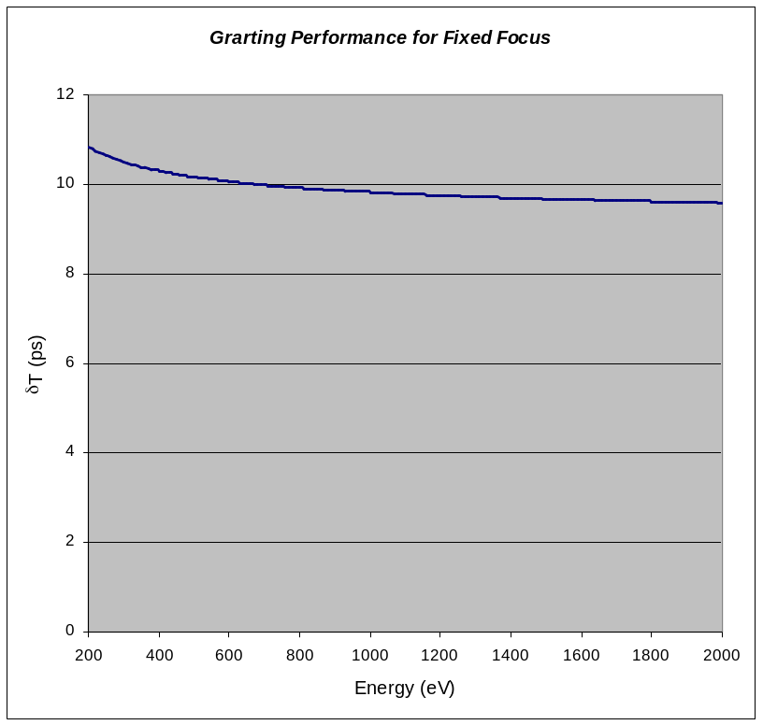
Time Delay
Optical delay
  Variable when tuning energy
    ~ 10 ps +/- 10%
    Variation Minimized by optimize Π
M₁
M₃
ξ
M₂
γ ’
H ’
H
Π
η
G

Slide 28
Sagittal Plane
Optical components
  (Sagittally) Focusing mirror
  Deflecting pre-mirror
  Deflecting VLS Grating
  Deflecting collimation mirror
M₁
M₂
G_{v}
M₃
Z_{R}
M₃
w₀
w₀’’
ΔL_{Re-entrant}
L₁
r_{M1M2}
r_{M2G}
r’_{G}
r_{M3}
r’_{M3}
r’_{M1}
Δr_{Re-entrant}
r_{total}
 | L₁ | r’_{M1} | Δr_{Re-entrant} | r_{total}
200 eV | 13.761030 | 13.731681 | 0.492233 | 27.984945
2000 eV | 13.761030 | 14.247250 | -0.023708 | 27.984572

Slide 29
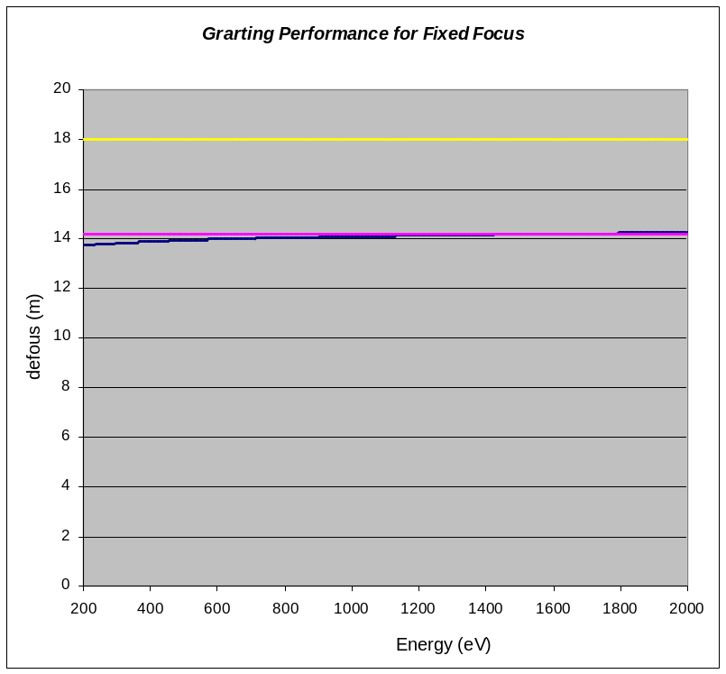
Coherent Beam Propagation
  ABCD matrix for Gaussian beam w/ const. ξ
Designed Location of waist
Designed location of reentrant point
Actual location of waist
Ray-optics
location
object
image
Re-entrant
point
w₀
z_{R}’
w₀’
z_{R}
r’(λ)
δr’(λ)
r
r’_{non-coherent}

Slide 30
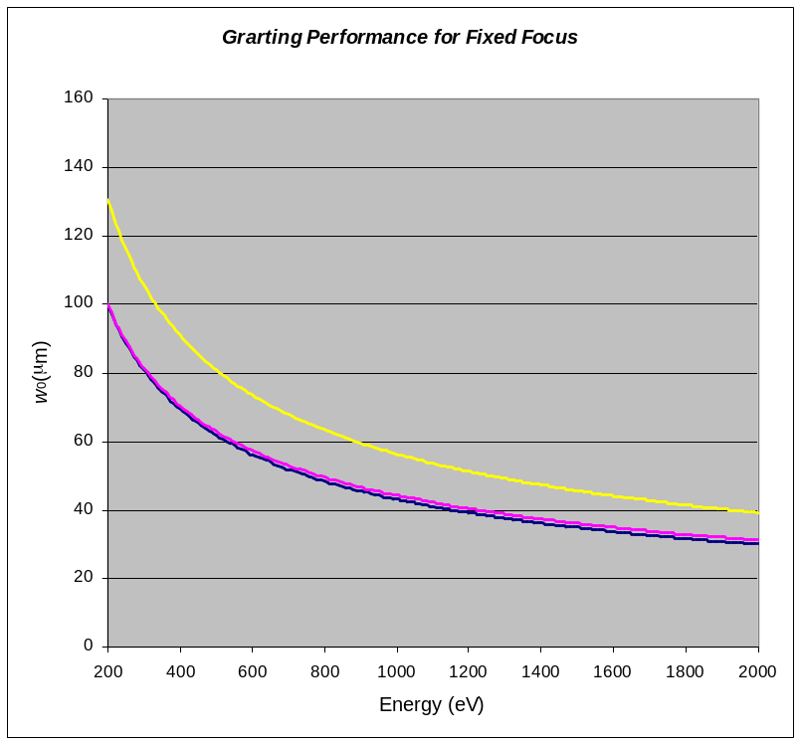
Beam Size in Sagittal Plane
Beam size evolution
  Focusing mirror
Ray-optics
location
object
image
Re-entrant
point
w₀
z_{R}’
w₀’
z_{R}
r’(λ)
δr’(λ)
at designed location
(ray-optics)
r
r’_{non-coherent}
re-entrant
point
source

Slide 31
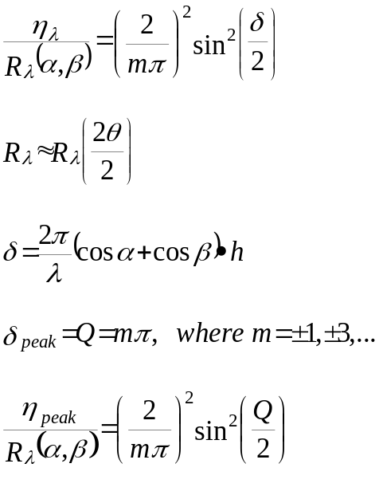
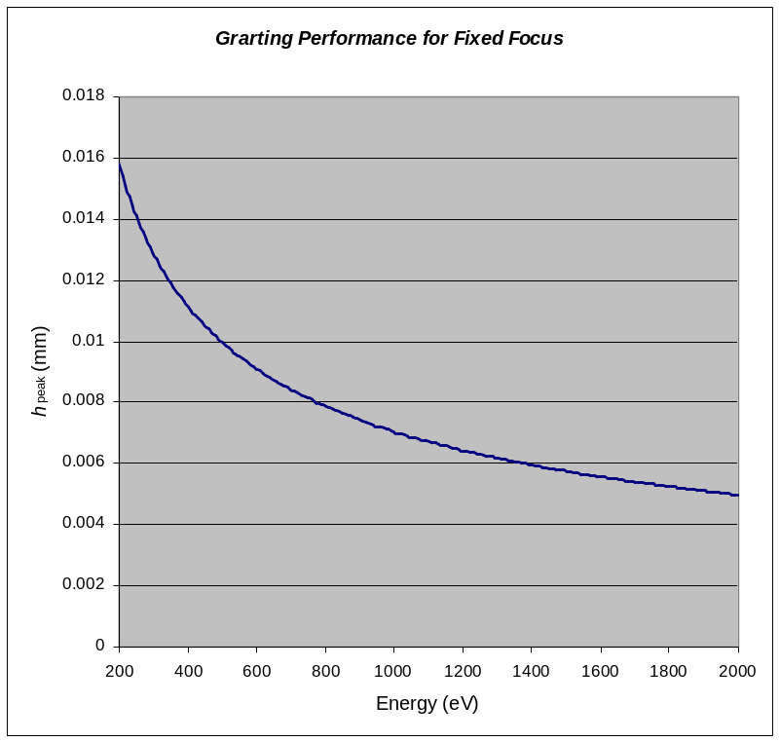
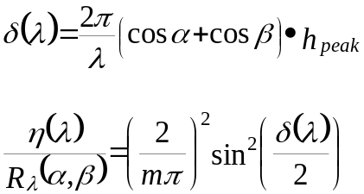
Grating Efficiency Estimate
Optimization of groove depth
  For square wave lamella
  h_{peak} only good for one energy
σ
σ_{L}
h
h_{peak}

Slide 32
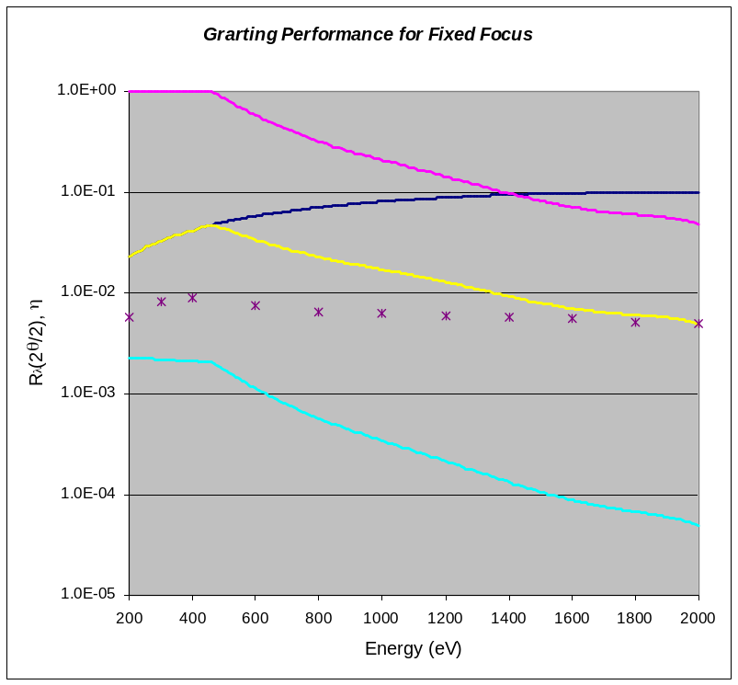
Grating Efficiency
Overall throughput
  M₁ ~ 100%
  M₂ ~ 100%
  G ~ R_{λ}·η_{λ}·b ~ 0.2% - 0.005%
    Reflectivity R_{λ}
    Estimated grating efficiency η_{λ}
    Bandwidth factor b
    Beam size mismatch (very small)
  M₃ ~ 100%
More rigorous calculations
  Done by J.Krzywinski*
    η_{λ} agrees with estimate at 2000 eV
    η_{λ} 1/3 of estimate at 200 eV
    Feature at 450 eV is evident
reflectivity
grating efficiency
grating efficiency
Reflectivity x grating efficiency
Reflectivity x grating efficiency by J.K.
overall throughput
including bandwidth factor
*Derived by solving Helmholtz equation in inhomogeneous media, in paraxial approximation

Slide 33
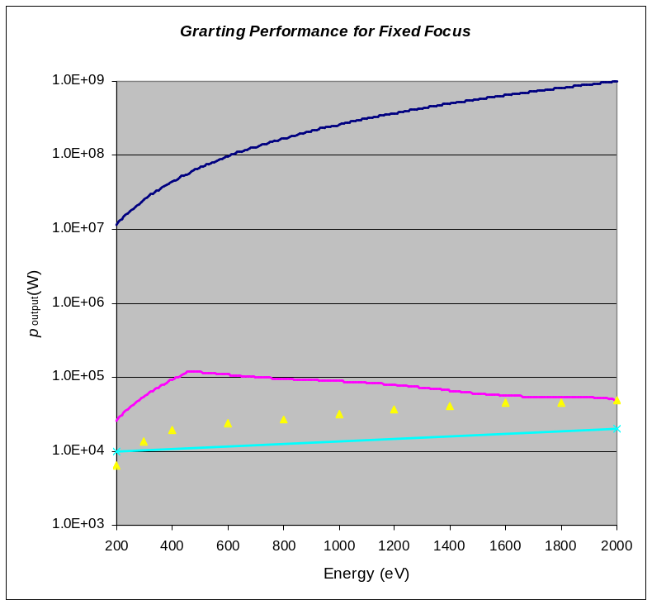
Seeding Power
Output power
  p_{output} ~ p_{input}·R_{λ}·η_{λ}·b
    Estimates indicate goal is met
      Simple amplitude grating estimate
      J.K. rigorous calculation
input power
output power
output power by K.J.
design goal

Slide 34
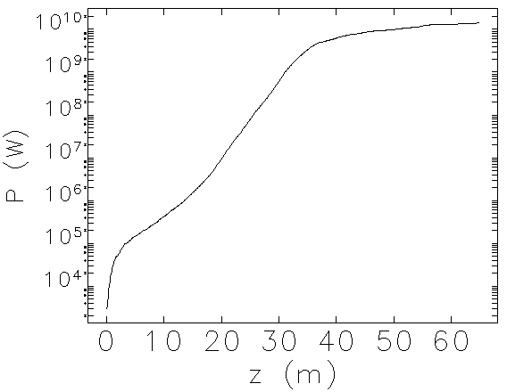
Increase Input power?
6-Å FEL power along the first undulator
saturation around 32 m with power ~10 GW
Present LCLS-II plan uses 40 meter long undulators

Slide 35
Optics Specs
Grating specifications
Parameter | symbol | value | unit
Line spacing | σ | 0.45 | μm
Linear coeff | Δσ/Δx | -1.5527x10⁻⁷
Groove height | h | 4.984 | nm
Grating profile |  | Lamella/Steps
Incident angle | θ | 8.963 – 28.26 | mrad
Exit angle | θ ’ | 53.3 – 168.6 | mrad
Included angle | 2θ | 176.4 – 168.7 | degree
Object distance | L_{obj} | ~ 18 | m
Image distance | L_{img} | ~ 6 | m
Exit slit | s | 4 – 13 | μm

Slide 36
Optics Specs
Mirror specifications
Parameter | symbol | value | unit
Cylindrical mirror Radius | R₁ | 0.2106 | m
focal length | f₁ | 7.800 | m
Incident angle | ξ/2 | 13.50 | mrad
Planar mirror
Incident angle | γ ’/2 | 8.14 – 75.4 | mrad
Spherical Mirror Radius | R₃ | 63.780 | m
focal length | f₃ | 0.30215 | m
Incident angle | η/2 | 9.475 | mrad
Offset-1 | H | 0.1200 | m
Offset-2 | H ’ | 0.1145 | m
Offset-3 | Π | 5.518 | mm

Slide 37
Optics Specs
Performance
Parameter | symbol | value | unit
Energy range | ε | 200 – 2000 | eV
Pulse length (rms) | τ | 34 – 12 | fs
Pulse energy | E | 1.2 - 40 | μJ
Peak Power | P_{input} | 10 - 1000 | MW
E-beam size (rms) | s | 50 -15 | μm
Resolving power | R | > 23000
Throughput | η_{total} | 0.2 – 0.005 | %
Output peak Power | P_{output} | 26 - 49 | kW
Time delay | ΔT | 10.837 – 9.595 | ps

Slide 38
Ray-Tracing Calculations
Input parameters
  Source
    Spatial
      Gaussian
    Angular
      Gaussian
  Grating parameters
    Object/image distances
      L_{object} = 18.000 m, L_{image} = 6.000 m
    Input/exit angles
      α = β = 2θ/2 = 88.2175º
    Polynomial (variable-line-spacing)
      Groove density = 22222.22 l/cm
      Linear coefficient = 76.89 l/cm²
      Mount = TGM/Seya
      Auto-tuning
      Signed

Slide 39
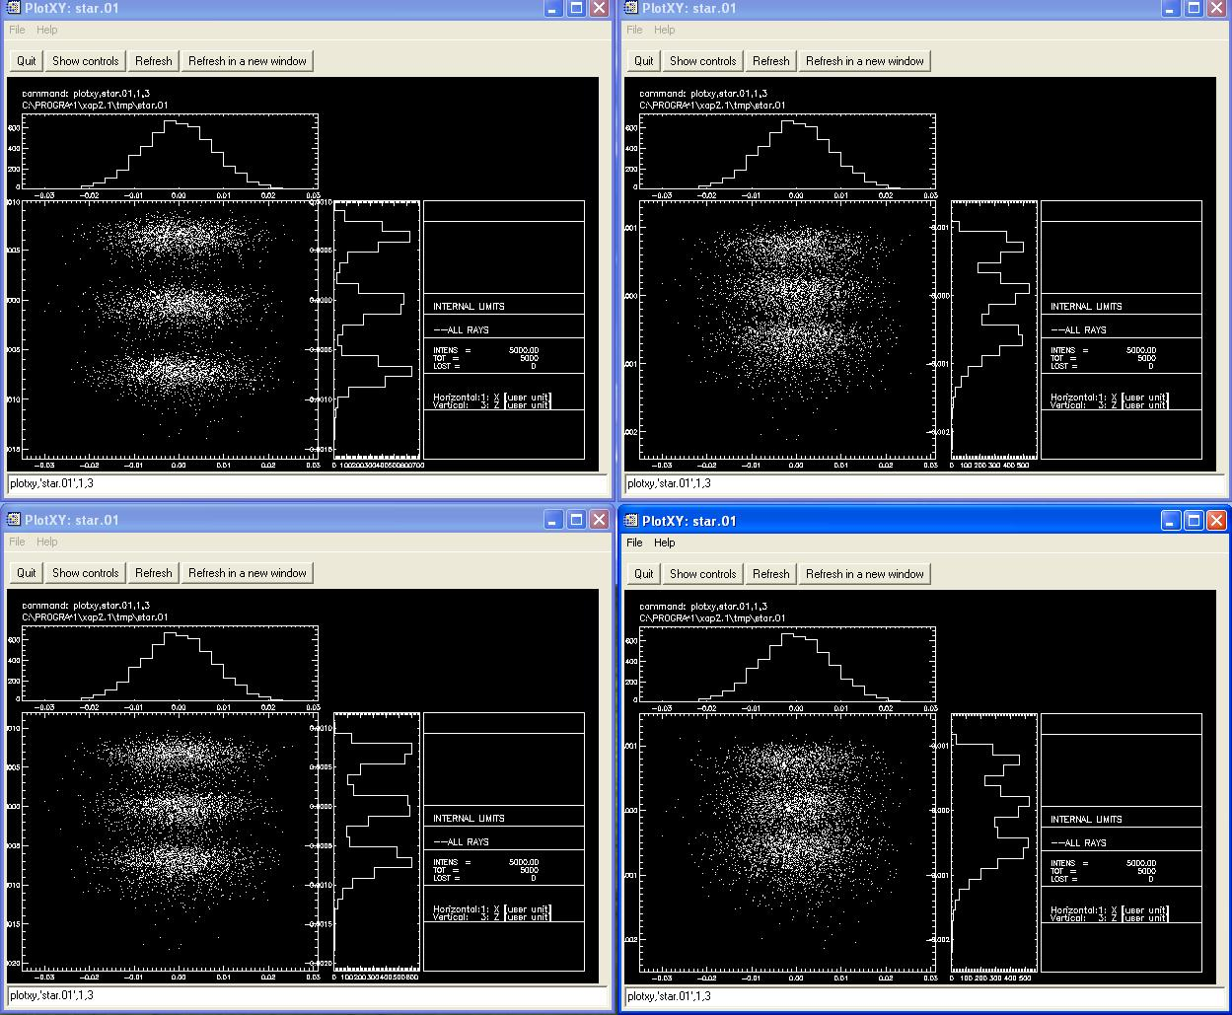
Ray-tracing @ 2000 eV
Grating focusing (2000, 2000.088, 1999.912 eV)
Best focus
g₁ = 76.89
g₁ = 76.39
Fixed linear
coeff.
g₁ = 76.59
g₁ = 77.39

Slide 40
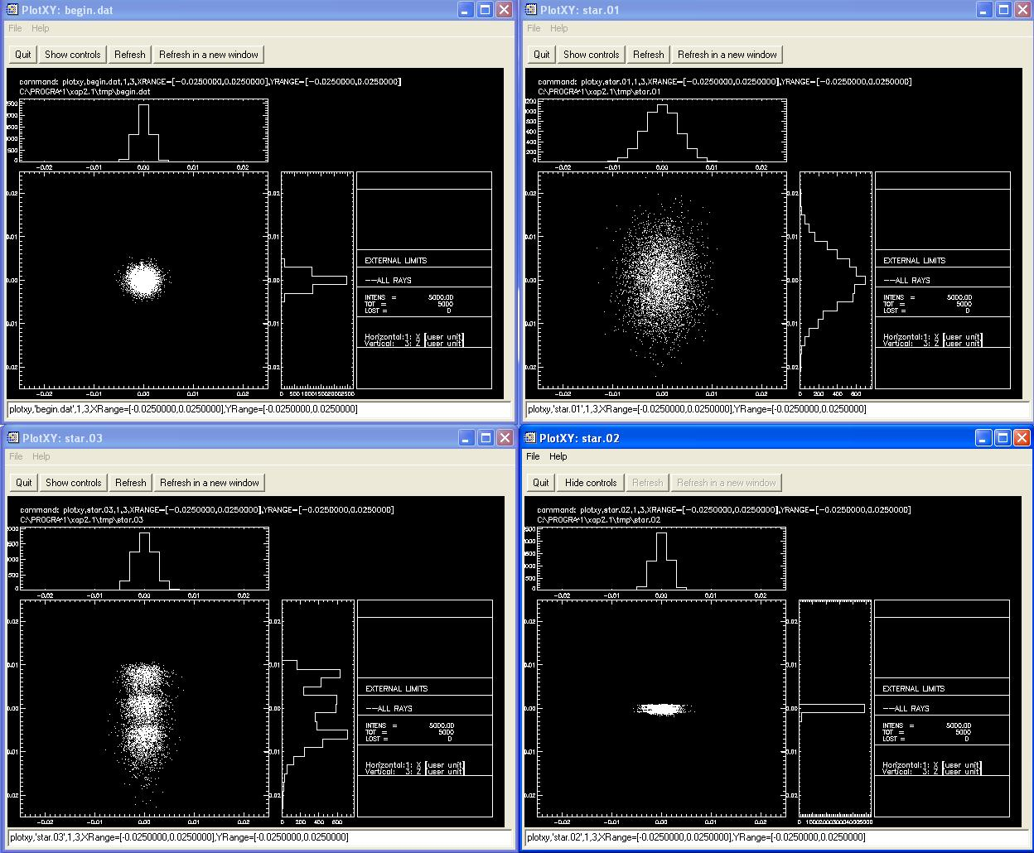
End-to-end Results
Source to re-entrant point simulation without exit slit
at source
(E, E+ΔE, E-ΔE)
at grating
after M1
at re-entrant
point after M3
(no slit)
at exit slit location
after grating
(no slit)

Slide 41
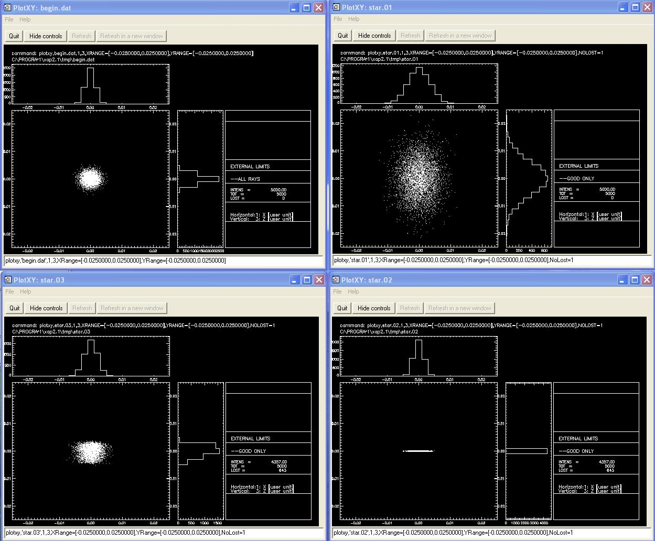
End-to-end Results
Source to re-entrant point simulation with exit slit
at source
(E, E+ΔE, E-ΔE)
at grating
after M1
at re-entrant
point after M3
at exit slit
after grating

Slide 42
Summary
Design meets all requirements
  High-resolution Grating Monochromator
    Fixed-focus operation excellent choice
      Only single grating needed
      Capable of tuning entire energy range
      Defocusing effects understood
      Few moving parts
    Efficiency sufficient for seeding
      Estimate and rigorous calculation indicate enough output power after mono
    Delay is variable
      but only weakly energy dependent
  Mirrors
    Pre-mirror
      Enables fixed-focus operation
    Vertical collimation mirror
      Re-collimates mono beam at entrance point
      Has a short focal length, defocus effect is evident, but could be compensated
    Horizontal focusing mirror
      Focuses input beam at entrance point

Slide 44
Supporting Slides
Alternative configurations
ABCD formulations
  Ray-optics
  Gaussian beams
  Arbitrary coherent beams

Slide 45
Alternative Configurations
Possible solutions
 | M₁ | M₂ | G | M_{f} | S | M₃ | Note
Current configure | Cylindrical (sagittal plane) | Planar | Planar-VLS |  | Fixed (small translation) | Spherical (tangential plane) | VLS needed
Configure - II | Cylindrical (sagittal plane) | Planar | Planar | Spherical (tangential plane) | Fixed | Spherical (tangential plane) | Extra mirror needed
Configure - III | Spherical (tangential plane) | Planar | Planar |  | Fixed | Toroidal (tangential & sagittal planes) | Footprint on grating too small
M₁
M₃
ξ
M₂
γ ’
H ’
H
Π
η
G

Slide 46
Example: design @ 2 keV
Optical pulse parameters
  E = 2000 eV
  λ = 6.200 Å
  t = 2.068 as
  ΔT_{FWHM} = 41.57 fs
    R = 22689 to make it fully transform-limited
  Transverse beam size
    Assuming predominantly TEM₀₀ mode
    Δx_{FWHM}=Δy_{FWHM} = 35.3 μm
    Beam waists w_{0x} = w_{0y} = 30.0 μm
    Rayleigh length
      z_{Rx} = z_{Rx} = πw_{0x}² /λ = 4.552 m, if fully coherent
        Diffraction-limited
      z_{Rx} < πw_{0x}² /λ = 4.552 m, if partially coherent
        Not diffraction-limited
Z_{R}

Slide 47
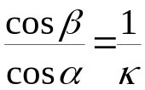
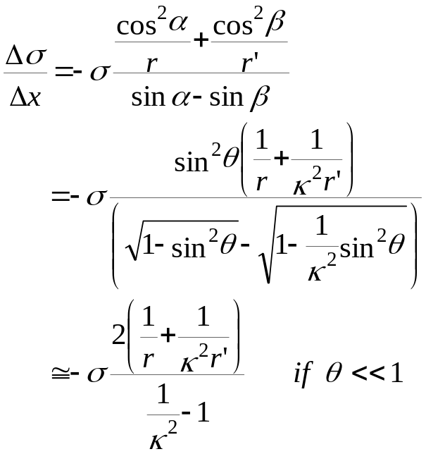
Variable Line Spacing Grating
  Fixed focal point operation
    Linear coefficient
Required for exact fixed focal-point
small angle limit

Slide 48
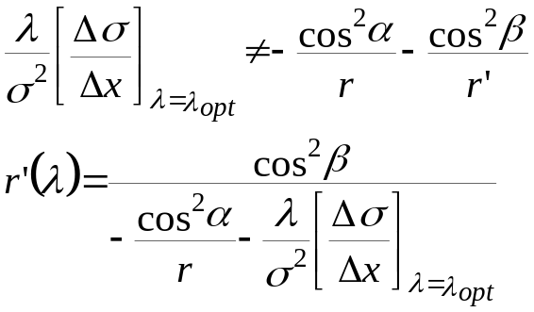
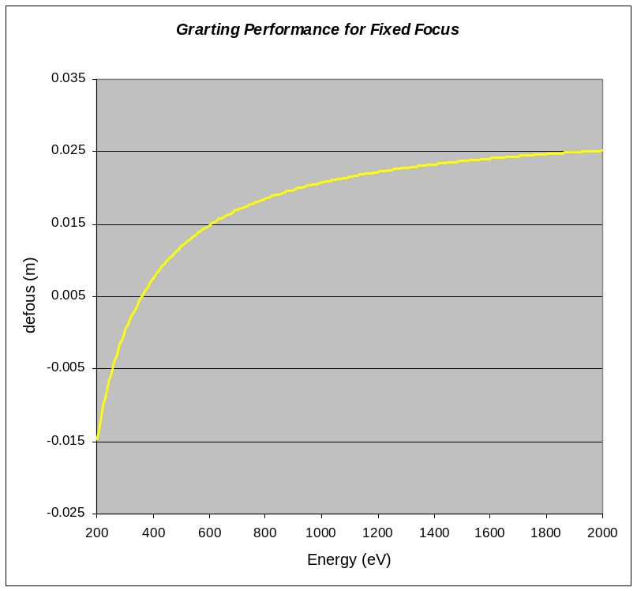
Variable Line Spacing Grating
  If Δσ/Δx = constant at λ_{opt}
    Effective focus location
    Effects of defocus
      Larger image size at exit slit
      Curved wavefront at exit slit
λ_{opt}
object
λ
image
w₀
λ’
w₀’
r’(λ’)
r
r’(λ)

Slide 49
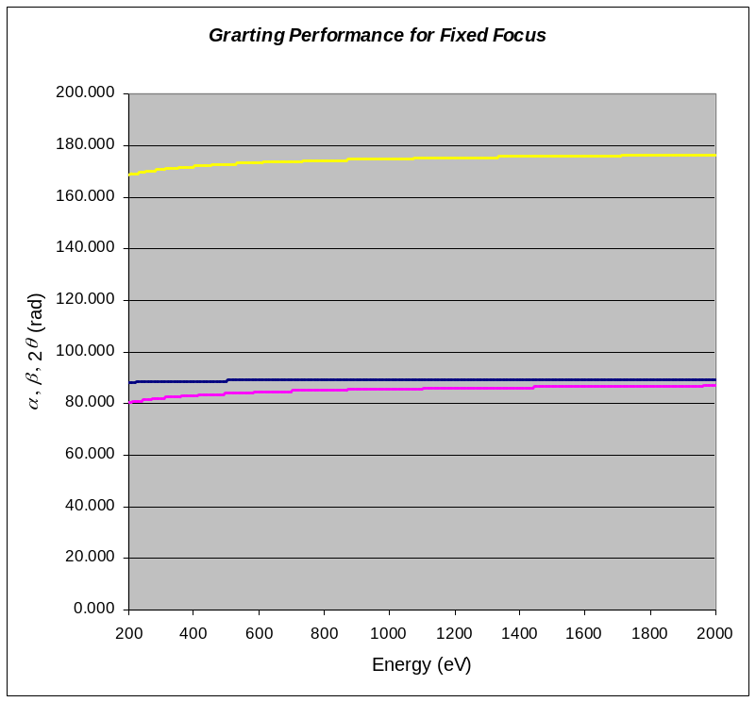
Operation of Pre-mirror
Function of pre-mirror
  Fixed focal point operation
    Exit angle (β) variable
      Rotation of grating
    Incident (α) & included (2θ) variable
      Motion of pre-mirror
        Rotation and effective translation
Included angle
incident angle
exit angle
M₁
M₃
ξ
M₂
γ ’/2
η
G

Slide 50


Operation of Pre-mirror
  Motion of pre-mirror
    Rotation
    Translation
      Variable
    ➔ Single rotation about a pivot point
M₁
M₃
ξ
γ ’/2
M₂
η
G

Slide 51


Rotation of Pre-mirror
Rotation of pre-mirror
  Center of rotation
    ½ distance Π above grating
  Paraxial approximation
Γ’
γ’
C
Π/2
Π
Pivot point
C
Π/2
Π

Slide 52

Effective Source Location
Variation in source location
  Optical path length difference
    Extremely small (~ 0.40 mm)
  Real concern
    jitter in FEL saturation point ( ~ 1 m)
Virtual source point
M₁
M₃
ξ
M₂
γ ’/2
H ’
H
Π
η
G

